Slide 1

Lecture – 8/25/2016
CSCI 36300 – Software Design

Slide 2
Pattern Overview

Slide 3
Design Patterns
What are software design patterns?
Solutions to common software problems arising with a certain context.
Why should we use such patterns?
Captures recurring structures that help to facilitate reuse of successful designs.
Objective:
Emphasize the Why, Where, and How – not just the What
Stand on the shoulders of giants – we don’t need to reinvent the wheel every time!

Slide 4
Types of Design Patterns
 | Creational | Structural | Behavioral
Description | Concerns the process of creating objects. | Concerns the composition of objects or classes. | Concerns the way in which objects or classes interact and the distribution of responsibility.
Examples | Factory, Builder | Controller, Façade | Visitor, Template

Slide 5
Design Patterns
Represented as relationships between objects with defined responsibilities that act in concert to carry out the solution.
Highly structured “language” to describe best practices.
Ease of Communication
Speak the same language.

Slide 6
Design Pattern Format
Name
Typically a “real-world” descriptor that we can use to identify the pattern.
Problem
Provides the when/how of the pattern.
Solution
The makeup of the application of the pattern and the responsibilities and roles of the associated entities.
Consequences
Provides the results and tradeoffs of applying the pattern.

Slide 7
Conclusion

Slide 8
Course Introduction Overview
What’s next?
Introduction to the various tools that we will be using this semester.
Review of C++ concepts and principles.
Motivation for the use of design patterns and best practices for creating quality software.
Be prepared to work!
This is a highly rewarding course – you get out of it what you put into it.

Slide 9
Questions?

Slide 10
Assignment #1

Slide 11
Assignment #1
Due Date: 9/8/2016
Character Array
Skeleton code that you will fill in and complete based upon the design requirements.
Must use the GitHub repository to complete the assignment.
You will not be uploading anything to Canvas.

Slide 12
Repository
The following requirements are applicable for all IU Github repositories used in assignment submissions.
Requirements:
The repository must be a private repository.
The repository must include the following users as collaborators:
rrybarcz (Me)
zpreynol (TA)
ahemmady (Grader)

Slide 13
Tools Overview

Slide 14
Tools Overview
Necessary Tools:
C++ Editor
A text editor will suffice but feel free to use whatever IDE you prefer.
GitHub Access
This will be where all assignments are “submitted.”
We will cover that in today’s lecture slides.
MPC
This will be used to generate the Makefile and other related files necessary for execution of your code.
We will cover this in today’s lecture slides.
Valgrind
This will be used for performance analysis of your code.
We will cover this briefly in lecture today as an introduction.

Slide 15
GIT Overview

Slide 16
GIT
GIT is a free, open-sourced distributed version control system.
https://git-scm.com/
Motivation:
Free version control system that was powerful enough to handle large software projects – while providing speed and efficiency in handling the workflow.
Created by: Linus Torvalds (of Linux fame) – 2005.

Slide 17
GitHub Introduction

Slide 18
GitHub
So what is GitHub?
It is simply a web-based Git repository hosting service.
Launched in 2008.
It provides you a UI, unlike Git which is strictly at the command line.
We all like flashy things! ☺
You can still use the command line features though…and we will through GitBash or Tesla/Pegasus.
https://github.iu.edu
IU Knowledge Base: https://kb.iu.edu/d/bagk

Slide 19
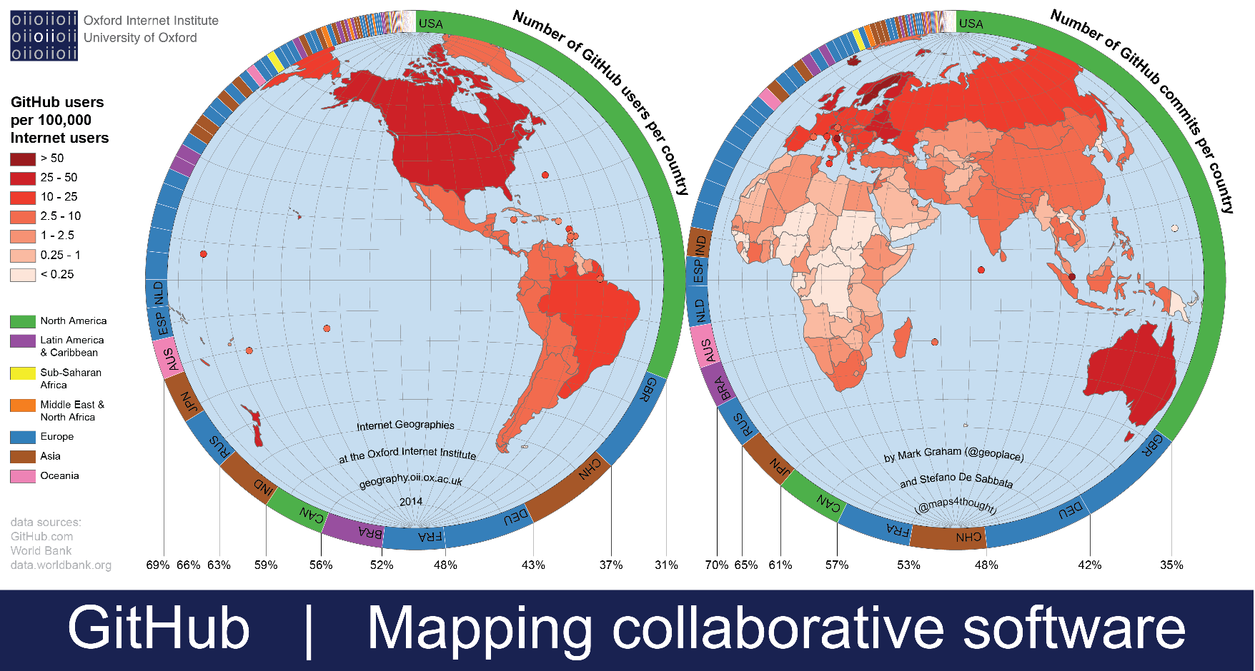

Slide 20
GitHub Exercise

Slide 21
GitHub – Step 1
Public/Private Key Access
HTTPS
Requires a handshake each time you access the GitHub repository (username/password).
SSH
Public/Private key authenticate is done – the public key is stored on the web server and the private key is maintained on your local machine.
Note:
Use “git@github.iu.edu” instead of “git@github.com”
https://help.github.com/articles/generating-ssh-keys

Slide 22
GitHub – Step 2
Creating A Repository
Create a private Git repository on the IU GitHub.
Example: csci36300-git-example
It is easiest to accomplish this through the web front end provided on the IU GitHub site.
Make sure to select the private option when creating your repository, otherwise everyone can see/access it.

Slide 23
GitHub – Step 3
Initial Download of Repository Contents
Now that we have our repository setup we need to clone it.
Cloning the repository is the primary method for initially downloading the contents of the remote hosted repository onto your local machine in your home directory.
We can use Tesla or GitBash to accomplish this using the following command:
git clone git@github.iu.edu:[username]/csci36300-git-example.git [destination path/directory name]

Slide 24
GitHub – Step 4 (Part I)
Adding
When you clone a Git repository, you have a personal copy of the entire repository on your local machine.
An advantage of this approach is that you can add and commit without having to communicate with the originating server (e.g., Github).
Adding a file to your local copy of the repo is simple. We just use the add command.
git add [filename]
When you add a file to the local copy, it notifies Git that a file is ready to be committed.

Slide 25
GitHub – Step 4 (Part II)
Committing
Files are not saved to the repository until you commit it using the commit command.
git commit –m “[Commit Comments Go Here]”
Like with any command line instructions you can add “optional parameters,” here we added –m which allows for a commit message (comment). The GitHub documentation provides a list of all the parameters available.
At this point all of our changes are still local to our repository…we need to push them out to the IU GitHub.

Slide 26
GitHub – Step 5 (Part I)
Pushing
We now want to “push” our changes out to the IU GitHub. To accomplish this we use the Git command of push.
git push origin master
git push [location] [branch]
The command above is pushing to the origin location of the master branch. If you want to push to a different location you would just need to specify the respective parameters.
When working with collaborators, they will also push their changes as well. We will eventually want to integrate their changes into our workspace. This is when we want to pull from the repository.

Slide 27
GitHub – Step 5 (Part II)
Pulling
The pull command is similar to the push command in terms of its syntax. If you do not specify a branch, then it pulls everything that is new and merges the changes into your local repository.
git pull origin master
git pull [location] [branch]
Again, we can specify the specific location and branch to “pull” from.

Slide 28
GitHub – Step 6 (Part I)
Branching
Branching is a useful approach that allows multiple different development tracks to be taking place at once. By branching we can continue to work without interrupting the main or master branch.
git checkout -b branch1
The command above will create a branch named branch1 and switch your working copy to branch1. The –b parameter specifies that we are giving it a branch name.

Slide 29
GitHub – Step 6 (Part II)
Merging
When we want to put everything back together we need to merge our changes back into the IU GitHub.
The easiest way to do this is on IU Github portal using a pull-request.
Go to the branch1 web page on Github: https://github.iu.edu/[user]/csci36300-git-example/tree/branch1
Click the Pull Request link.
Complete the fields on the page and click the Send pull request button.

Slide 30
GitHub – Step 6 (Part III)
Merging
You will also notice the text above the Send pull request links reads, “Able to Merge”.
After clicking the previous link, you will be routed to a page where you can review the difference between source content (i.e., the content on branch1) and target content (i.e., the content on master) merged with.
This is called a diff.
Click the Merge pull request button to complete the merge of branch1 with master. You can check the option to delete branch1 after the merge if you like.

Slide 31
GitHub – Step 7
Success!
Now, go back to your IU GitHub repository, and pull master from origin. You should notice that the master branch in your local copy of the repository now contains the merged content that we just saw online.
If you have completed this you have successfully demonstrated the needed skills to successfully manage your IU GitHub repository.
Make sure to reference the GitHub help and manuals for variations of the commands. Note: GitBash is similar to a Linux environment (Tesla).

Slide 32
GitHub - Exercise
Your task is to create a simple sample repository to help familiarize yourself with GitHub.
Exercise:
Add me as a collaborator (rrybarcz).
I will verify that you have setup your GitHub correctly and notify you of the completion of this task.
This will not be graded but is essential that you complete so that you have the knowledge to start your first assignment.
I will be checking your GitHub repository to ensure that you satisfy this task.
This will verify that you are ready for Assignment #1.

